Slide 1
AI PM COPILOT
Team
Sweta Sen
Abhishek Bhattacharya
Samrose sultana
Shivaprasad Sunka
Vidya Karthikeyan
Sharmila
Karthik Rathinam

Slide 2
:: Pull from Docker Hub
docker pull yourDockerHubUsername/ai-pm-copilot:latest
:: Run with MFA login (default)
docker run -it --rm ^
--env-file .env ^
-v "%cd%\data:/app/data" ^
yourDockerHubUsername/ai-pm-copilot:latest
:: Skip MFA, go straight to copilot
docker run -it --rm ^
--env-file .env ^
-v "%cd%\data:/app/data" ^
yourDockerHubUsername/ai-pm-copilot:latest python main.py
:: Add a user
docker run -it --rm ^
--env-file .env ^
-v "%cd%\data:/app/data" ^
yourDockerHubUsername/ai-pm-copilot:latest python login.py --add-user
:: Run tests
docker run --rm ^
--env-file .env ^
yourDockerHubUsername/ai-pm-copilot:latest python -m pytest tests/ -v

Slide 3
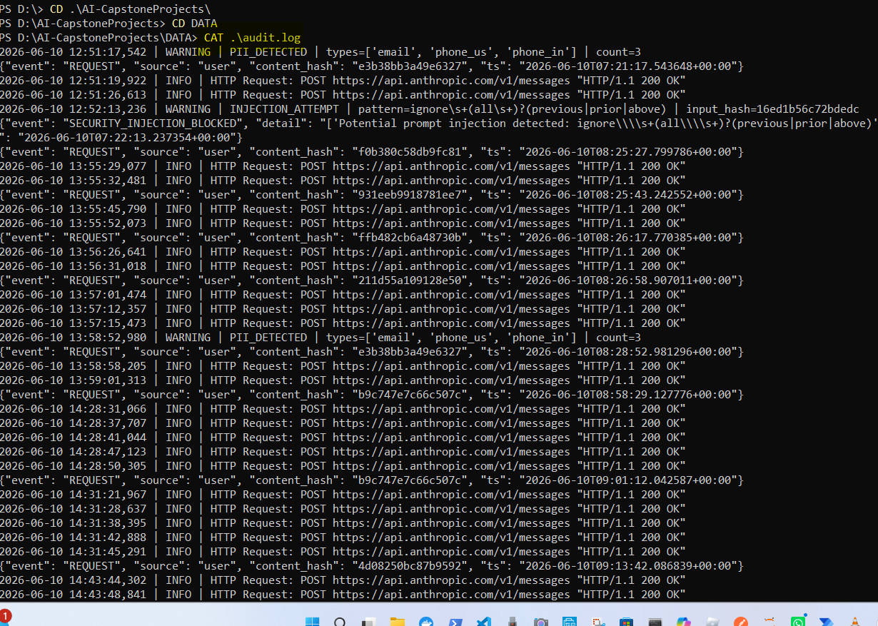
APPLICATION SCREESHOTS
Audit.log

Slide 4

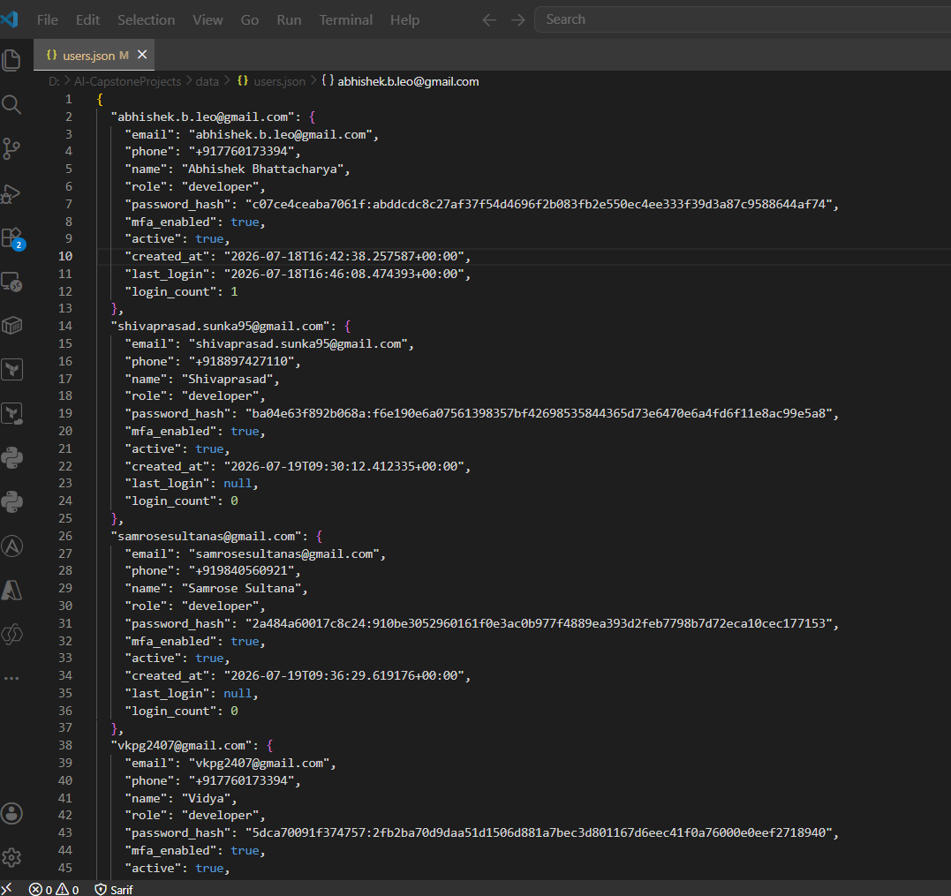
USERS.JSON
ALL PASSWORDS ARE HASHED AND CANNOT BE RETRIEVED BY HACKERS IN CASE COMPROMISED

Slide 5
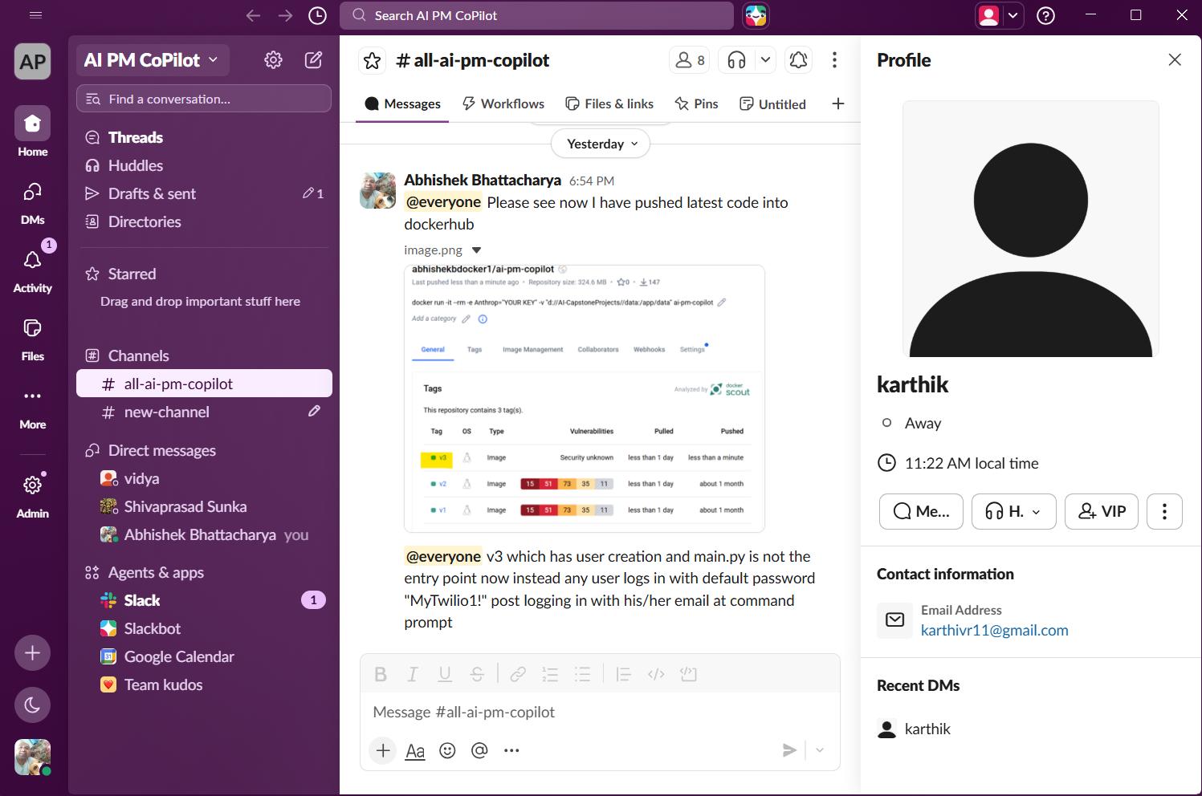
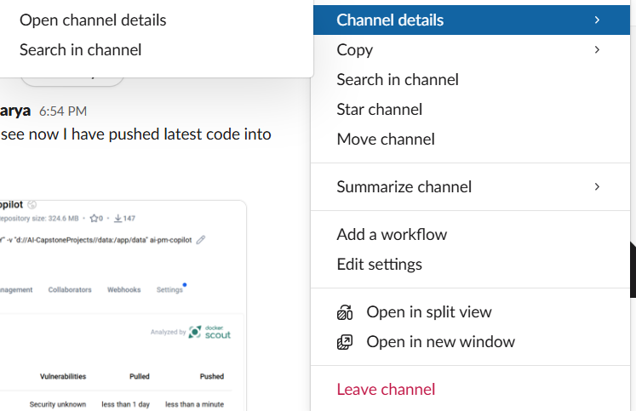
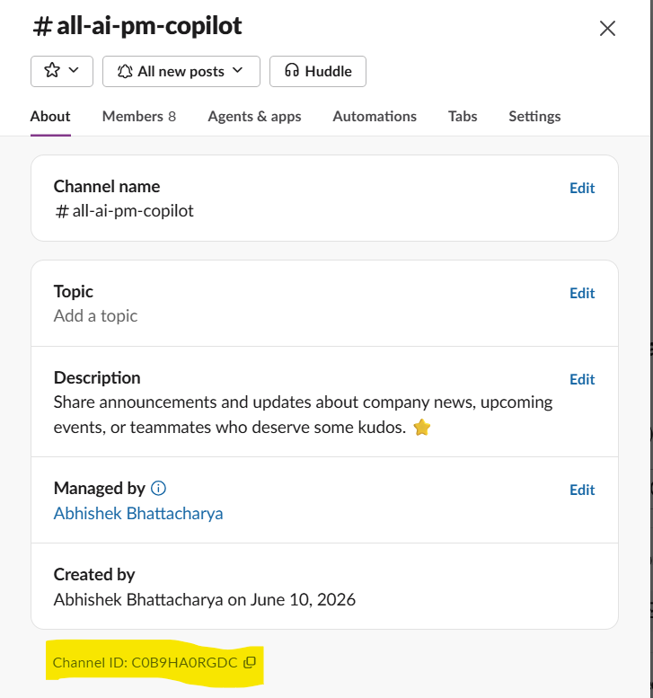
Slack channel
Integration is done via API key insertion in .env file
Channel Name
.env api key entries for slack channel

Slide 6
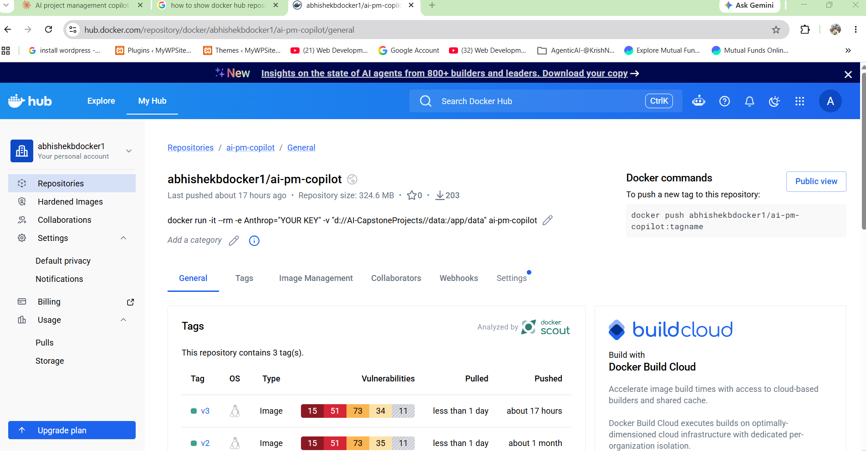
Docker HUB URL:
https://hub.docker.com/repository/docker/abhishekbdocker1/ai-pm-copilot/general

Slide 7
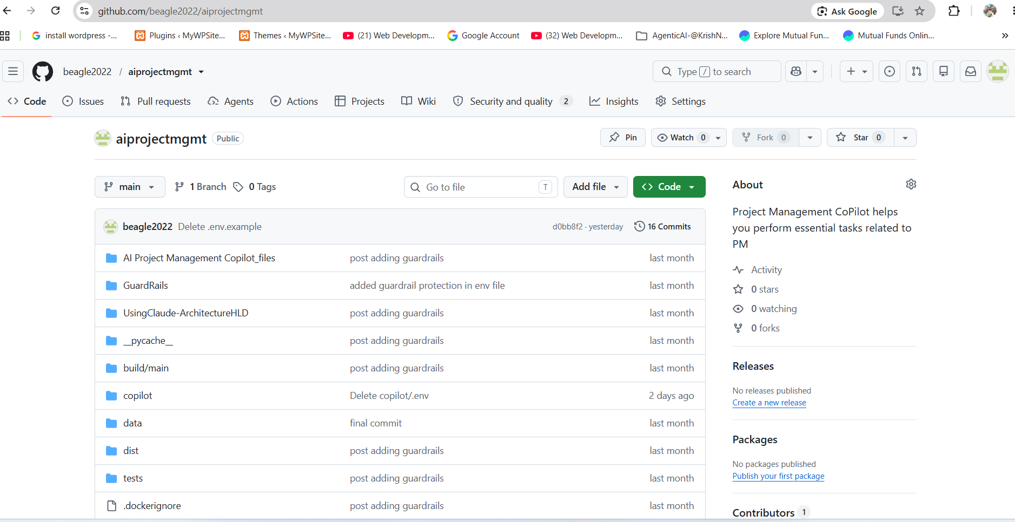
GIT HUB URL:
https://github.com/beagle2022/aiprojectmgmt

Slide 8
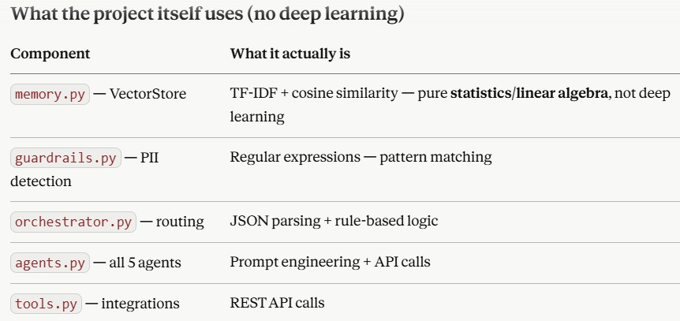

Slide 9
TOKENS: COST: BUDGET
You › tokens ← session usage report (since you started this run)
You › usage ← same as tokens
You › budget ← check today's spend + lifetime totals
You › cost ← same as budget
cd D:\AI-CapstoneProjects
python token_report.py # lifetime totals
python token_report.py --today # today only
python token_report.py --budget 5.0 # check $5/day limit
python token_report.py --csv # export to data/token_usage.csv
How token counting works
The Anthropic API returns exact counts on every call — response.usage.input_tokens and response.usage.output_tokens. The TokenTracker captures these from every agent call and every orchestrator call (routing, aggregation, direct replies), persists them to data/token_usage.json, and calculates estimated cost using the current pricing table.

Slide 10
What the report shows
Total calls : 6
Input tokens : 7,150
Output tokens : 1,925
Total tokens : 9,075
Estimated cost : $0.0503 USD
By agent:
code_reviewer 2,510 tok $0.0124 █████
orchestrator_aggregator 2,320 tok $0.0132 █████
sprint_planner 1,580 tok $0.0093 ███
By model:
claude-sonnet-4-6 9,075 tok $0.0503

Slide 11


